Slide 1
Loops
Do something many times

Slide 2
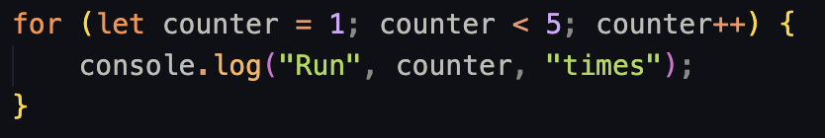
What are loops?
Loops, together with conditionals and functions, form the core of any programming language.
They allow us to run a block of code many times, but write it just once.
It looks very intimidating. Let’s break it down.

Slide 3

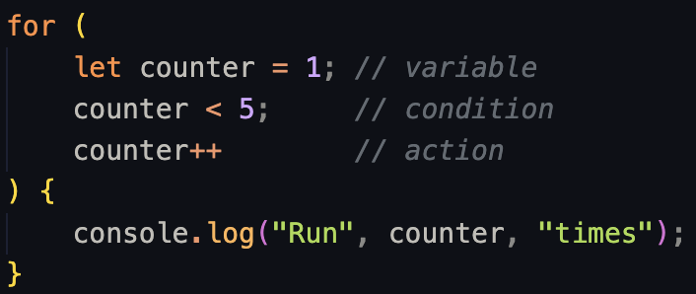
What are loops?
First, we use the keyword to tell the computer we’re writing a loop.
After it, inside the parentheses we have 3 statements.

Slide 4
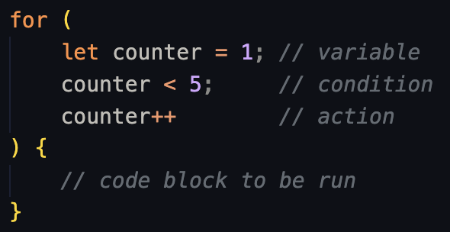
What are loops?
Variable declaration.
We declare a variable that will change over time. In this example it starts with a value of 1.
Condition.
Each time the loop runs, the condition will be checked. If it’s true, the code inside the curly braces will be executed. If it’s false, the code block will be skipped. Here, it’s if counter is 5 or more.
Action
Everytime the loop runs, after the code block is executed, an action will be performed. In this case, we’re incrementing the value of our counter by 1.

Slide 5
What are loops?
Here’s a little diagram of the flow:
Declare variable
Check condition
false
true
Run block of code
Perform action

Slide 6
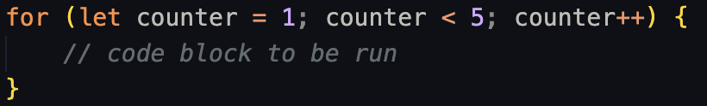
What are loops?
We usually write the 3 statements in a single line, just to save some space.
Variable
Condition
Action

Slide 7
What are loops?
Let’s go back to our first example and see how the computer would execute the code.

Slide 8


What are loops?
A variable is declared and assigned a value of 1.
The condition is checked. This time is true, since 1 is less than 5.
The code block is executed. Because counter is 1, it will print “Run 1 times” to the console.

Slide 9


What are loops?
Instead of reading the code below the loop, the action is performed. In this case the value of counter is incremented by one. Now counter equals 2.
The condition is checked again. It is true, since 2 is less than 5.
The code block is executed. Printing “Run 2 times” to the console.
Notes:
Let’s try this together in the console

Slide 10
What are loops?
This will keep happening over and over, until counter is 5. At this point, the condition will be false, because 5 is not less than 5.
The code block will be skipped and the computer will continue executing whatever code might be written below the loop.

Slide 11
Loops and arrays
Loops and arrays are best friends.
For example, let’s say we have an array and we want to log every element to the console.

Slide 12
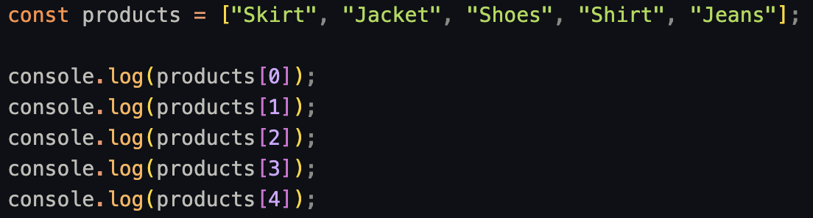
Loops and arrays
This code works, but if we want to add or remove items, we would have to manually write the code to reflect the change.

Slide 13
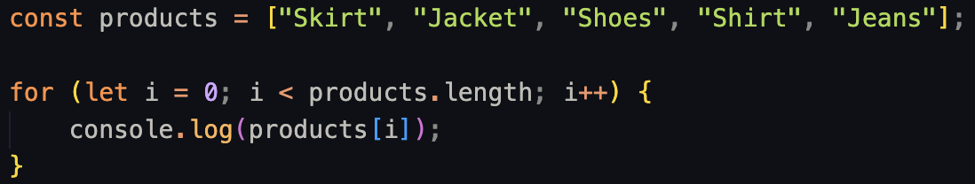
Loops and arrays
Instead, this code is a lot more concise (shorter).

Slide 14
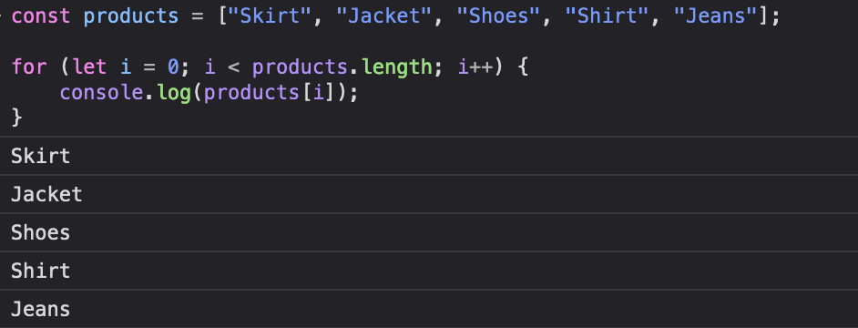
Loops and arrays

Slide 15
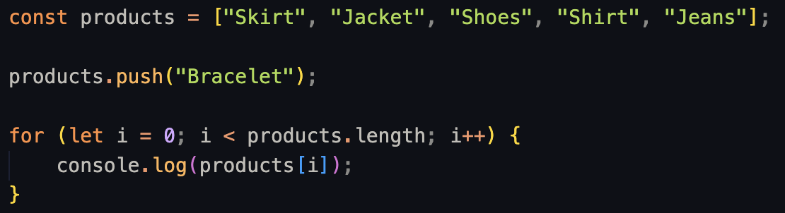
Loops and arrays
Also, it can accommodate changes to the array much easier. For example, if we pushed a new element into the array.

Slide 16
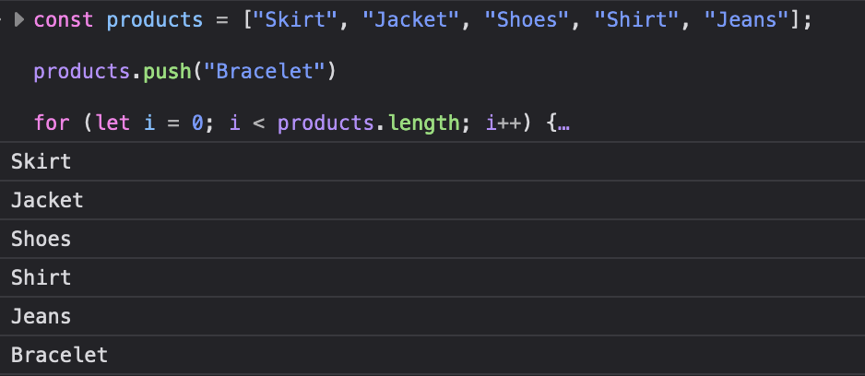
Loops and arrays

Slide 17
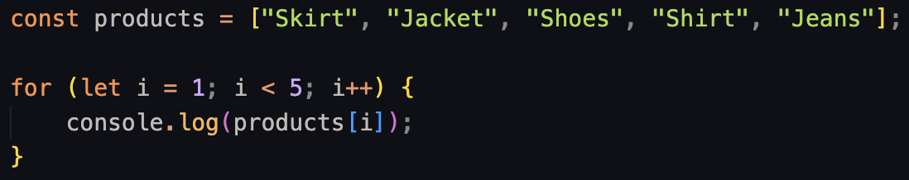
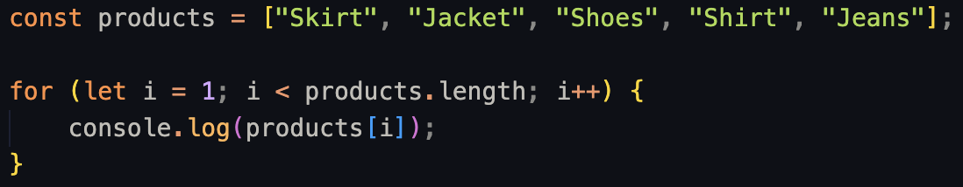
Loops and arrays
Let’s break this one down.
In this case, we name the variable i as short for “index”.
“Index” is the position of an element in a list (1st, 2nd, 3rd, …)
Index:
0
1
2
3
4
We initialize it to 0 since our first product has an index of 0

Slide 18
Loops and arrays
And the condition, instead of having a “hardcoded” value, will include the length of the array.
5
This way the loop will run as many times as items we have in the array, regardless of how many elements there are.
Notes:
Length starts at 1 instead of 0

Slide 19

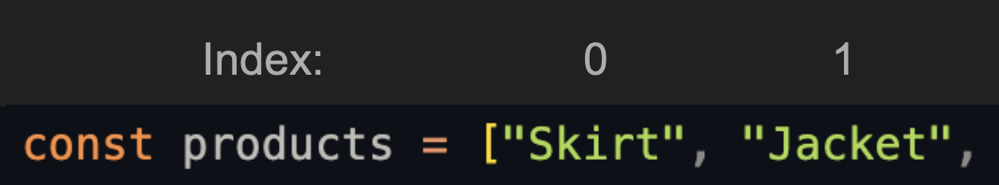
Loops and arrays
The first time the loop runs i will equal 0.
Then, inside the code block we’re getting an element from products with bracket notation.
This time we’ll be getting the element in the first position, since indexes start with 0.
…
It’ll be logged to the console, and the action (i++) will be performed.

Slide 20


Loops and arrays
The second time:
Condition is checked: true
i will equal 1
Code block runs
Console logs “Jacket”
Action is performed: i++ => i is now equal to 2
This will be repeated until i === 5, which will make the condition false.

Slide 21
Use case: calculate total price
So, we have multiple values in an array.
What can we do with it?
For example, if we have an e-commerce website, we could have a list with the prices of the products in our store

Slide 22
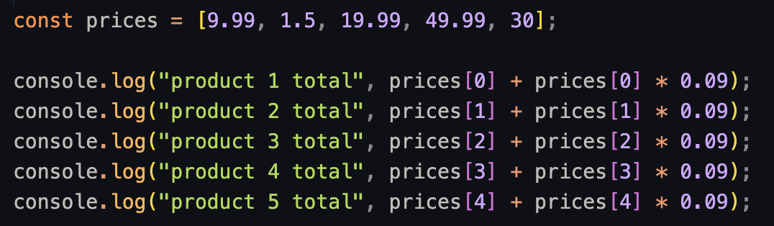
Use case: calculate total price
Now, we want to list the total price of the item, which will be the price + taxes.
But what if, for example, we need to change the tax percentage?

Slide 23
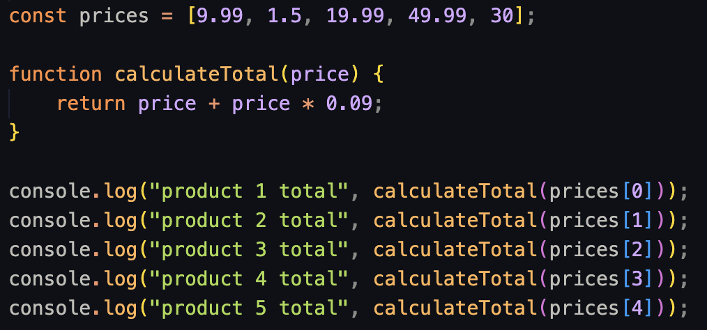
Use case: calculate total price
We’ve already learn to reuse logic with functions. But what happens if we add or remove an item? We’d have to manually write a new console.log with the calculation…

Slide 24
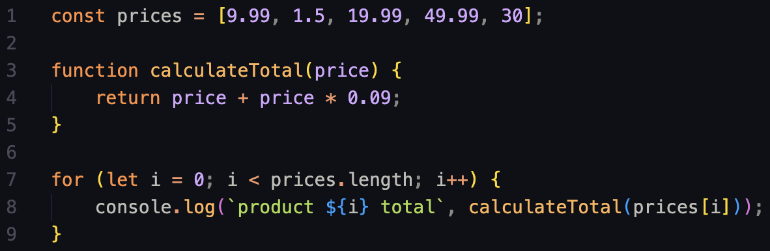
Use case: calculate total price
That’s where loops come in.

Slide 25
Use case: calculate total price
The variable i will start with a value of 0.
The condition is true, since prices.length is 5, and 0 is less than 5.
The first time it runs, the code block will be equal to this:
After it runs, the action (i++) will be executed, bringing i to a value of 1.

Slide 26
Use case: calculate total price
Then, line 8 will run again, but this time the value of i be 1.
The condition is checked again, and still returns true because 1 < 5.
The code block will now equal to this:
And after running, the action (i++) will be executed again, bringing i to 2.

Slide 27
Use case: calculate total price
This will happen again and again until i is not less than 5, in which case the condition will equal false and the code inside the loop won’t be executed anymore. The computer will then continue with the normal flow of the code, running the rest of the code below the loop.

